Slide 1
DATA HANDLING

Slide 2
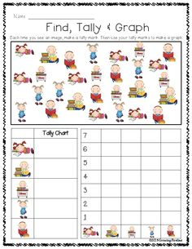
COLLECT AND SORT OBJECTS

Slide 3
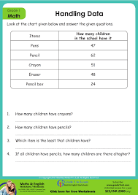
ANALYSE AND INTERPRET DATA

Slide 4
Reference

